Slide 1


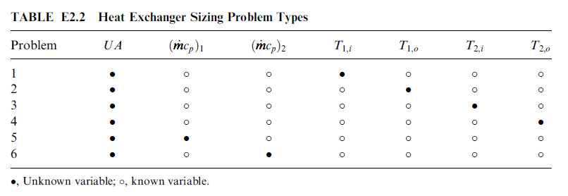
Some important considerations on HE design
Rating Problem (performance or simulation problem)
Known – terminal temperatures, flow rates
Unknown – A or UA
determination of heat transfer and pressure drop
of an existing exchanger or already sized exchanger
Sizing Problem (design problem)
Known – A or UA
Unknown – terminal values and pressure drop
Enthalpy rate change equation
Heat transfer rate equation
Fundamentals of Heat Exchanger Design by Ramesh K. Shah, Dušan P. Sekulić

Slide 2
Rating problem
Input:
Heat exchanger construction
Flow arrangement and overall dimensions
Materials selection and surface geometries on each side
Heat transfer and pressure drop characteristics (j or Nu and f vs. Re)
Fluid flow rates
Inlet temperature
Fouling factors
Output:
Fluid outlet temperature
Total heat transfer rate
Pressure drop on each side
Sizing problem
Input: heat transfer rate and pressure drop on each side
Output: exchanger construction type, flow arrangement, tube and shell size, materials of construction, exchanger size

Slide 3
Mechanical Design of Heat Exchanger
General idea and concepts

Slide 4
Mechanical design standards
Mechanical design of HE includes design of various pressure & non-pressure parts.
Structural rigidity & satisfactory service of HE depends on appropriate mechanical design.
Mechanical design is generally performed according to design standards & codes. Some mechanical design standards used in heat exchanger design are:
TEMA (United States)
IS:4503 (1967) (India)
BS: 3274 (United Kingdom)
BS: 20414 (United Kingdom)

Slide 5
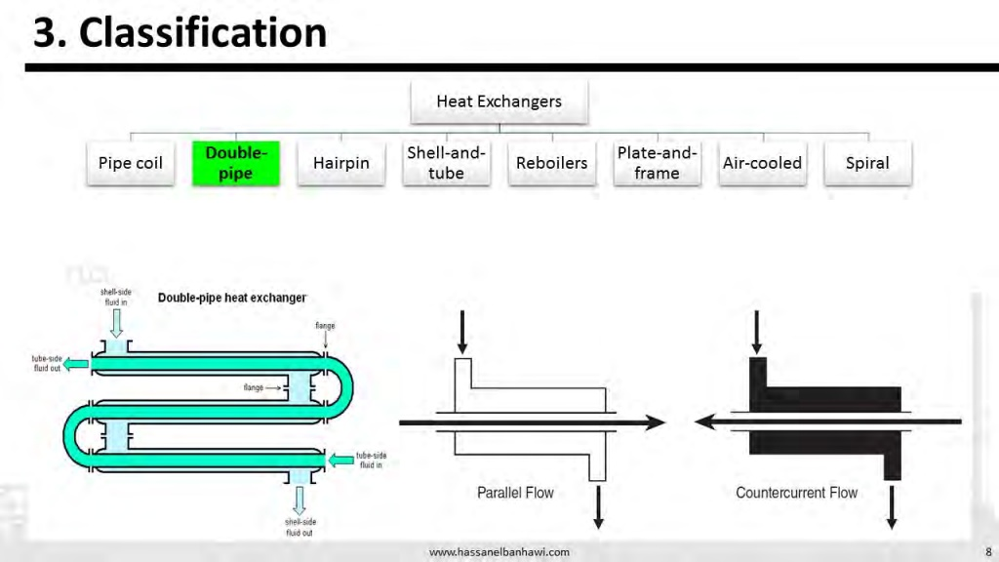

Slide 6
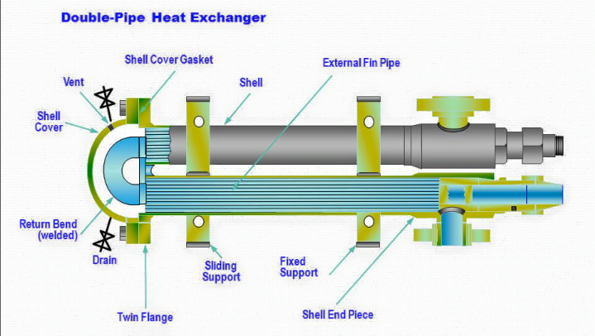

Slide 7
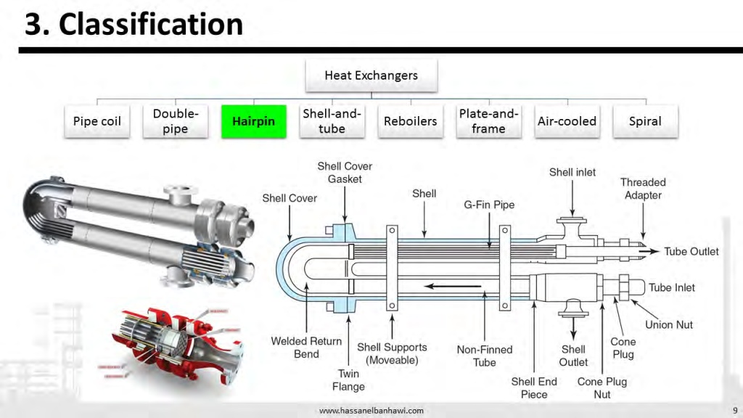

Slide 8
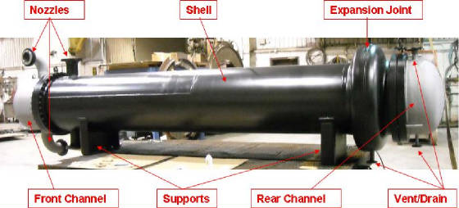
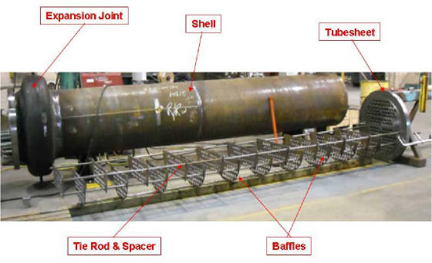
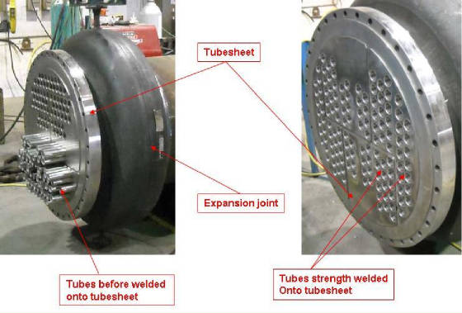
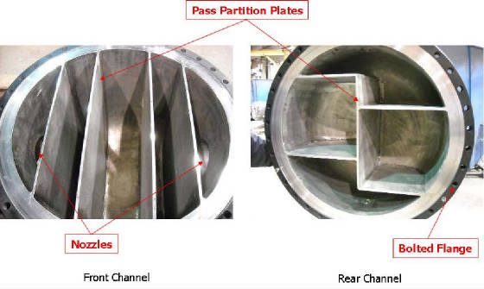
Parts of HE

Slide 9
Design Pressure & temperature
Design pressure:
Design pressure of a HE is gauge pressure at top of vessel. This pressure is used to determine minimum wall thickness of various pressure parts. The IS: 4503 design pressure should at least 5% greater than maximum allowable working pressure. Usually a 10% higher value is used.
Maximum allowable working pressure is gauge pressure for a specified operating temperature that is permitted for service of exchanger units. According IS: 4503, shell & tube sides pressure should be specified individually.
Design pressure specification is at 250, 120 and 65 ⁰C for carbon steel, stainless steel & non-ferrous metals respectively. Maximum permissible stresses for various HE components should not be exceeded at allowable pressure.

Slide 10
Contd.
Design Temperature:
Design temperature is used to determine minimum wall thickness of various parts of exchanger for a specified design pressure. It is normally 10 ^{ᵒ}C greater than maximum allowable temperature.

Slide 11
Materials of construction
All materials used for construction of shell and tube HE for pressure parts must have appropriate specification as given in IS: 4503
Materials of construction should be compatible with process fluids & others parts of materials & also should be cost effective
Maximum permitted operating fluid temperatures should not exceeds for various pressure-retaining components as specified by IS:4503
High chrome-Mo-Ni alloys (Cr content 12-27%) can be used for high temperature services up to 2100 ^{ᵒ}C. Use of any carbon or low alloy steel is not recommended for construction of HE for service below 0 ^{ᵒ}C.

Slide 12
Design considerations
Design pressure & temperature
Materials of construction
Design components
Shell diameter & thickness
Shell cover
Channel covers diameter and thickness
Pass partition plate
Tube sheet thickness
Impingement plates or baffles
Nozzles and branch pipes
Gaskets
Bolts design
Design of flange
Design of supports

Slide 13
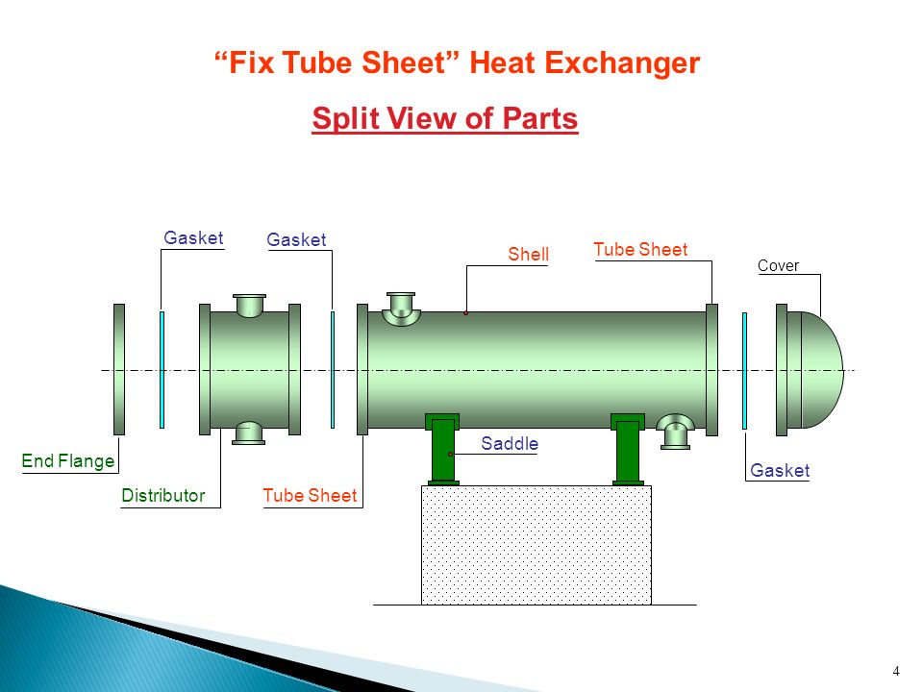

Slide 14
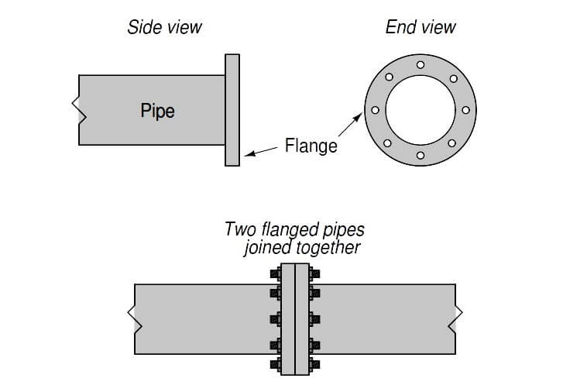

Slide 15
Design components
Shell diameter
Nominal diameter (outside diameter in mm rounded to nearest integer) of HE is specified in IS: 2844 (1964) in case of shells manufactured from flat sheet. Following diameters (mm) should be preferably used in case of cylindrical pipe shell: 159, 219, 267, 324, 368, 419, 457, 508, 558.8, 609.6, 660.4, 711.2,762, 812.8, 863.6, 914.4 and 1016.
Shell thickness
Minimum shell thicknesses should be decided in compliance with nominal shell diameter including corrosion allowance as specified by IS: 4503. Usually minimum shell thicknesses are in order for various materials for same service: Cast iron> Carbon steel≥ Al and Al-alloys (up to 700°C)> Cu and Cu-alloys≥ Ni≥ Austenitic stainless steel= Monel inconel

Slide 16
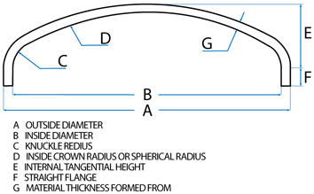
Shell cover
Different types shell covers used in shell and tube HE: flat, torispherical, hemispherical, conical & ellipsoidal
Torispherical head most widely used in chemical industries for operating pressure up to 200 psi
According to IS: 4503, minimum thickness of shell cover should be at least equal to thickness of shell

Slide 17
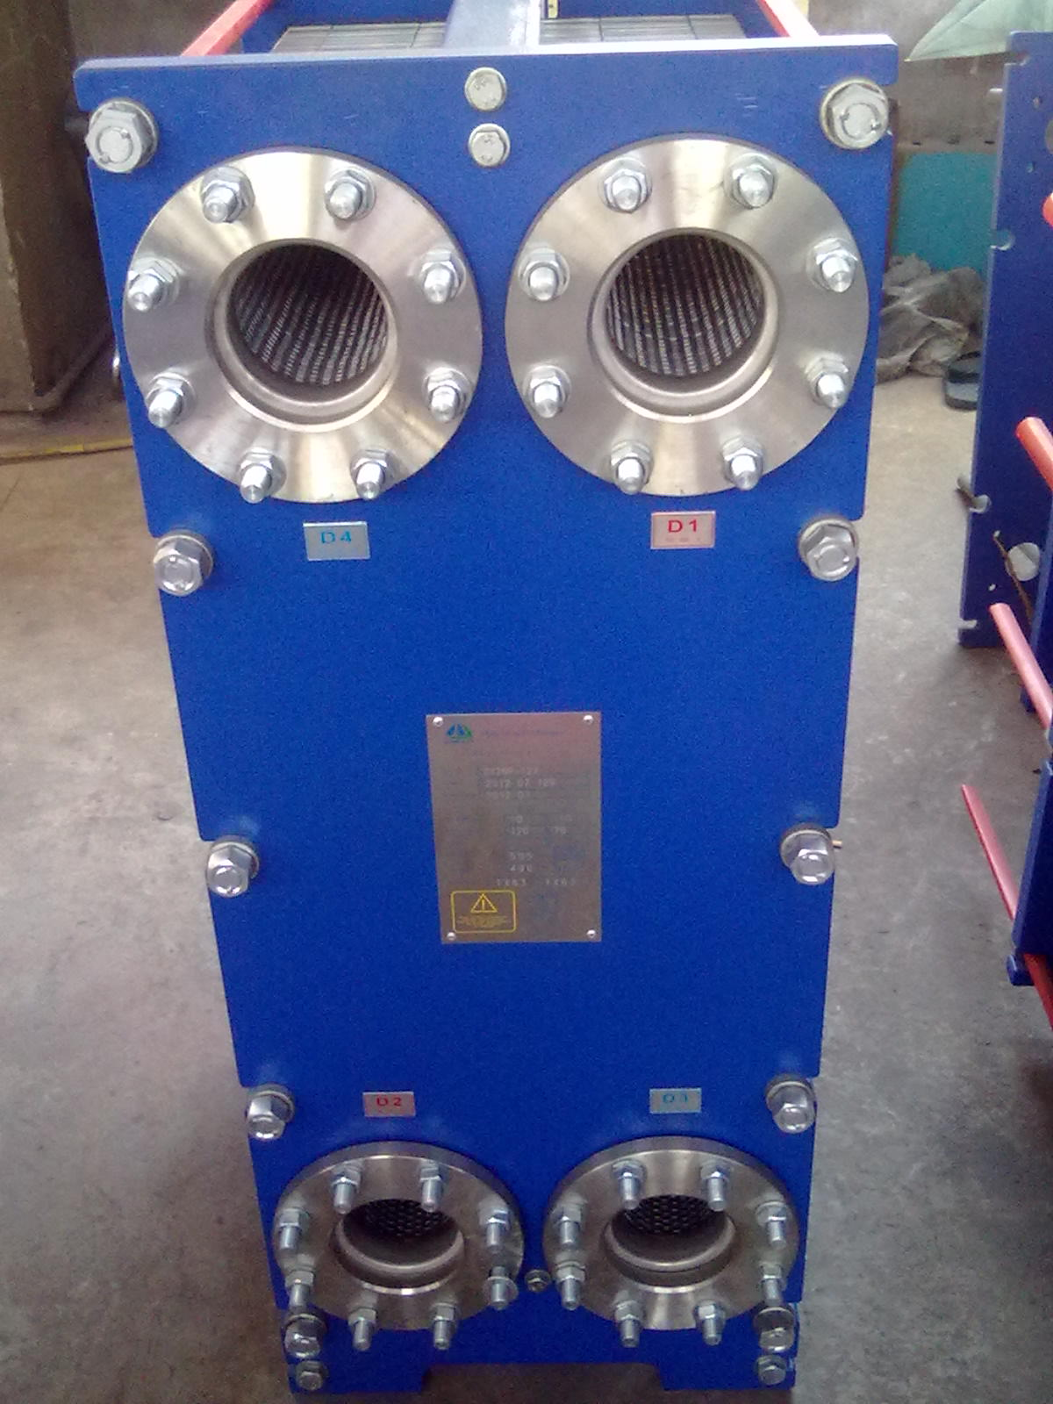
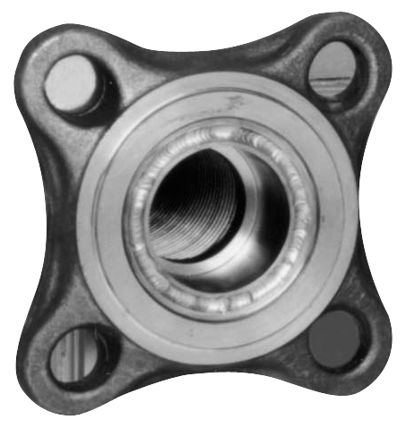
Flange

Slide 18
Design of flange

Slide 19
Mechanical design standards (TEMA specification) shell diameter and wall thickness
Most countries follow TEMA standards
TEMA standards are applicable for maximum shell ID & wall thickness of 60 & 2 inch, a maximum design pressure of 3000 psi & a maximum nominal diameter (inch) × design pressure (psi) of 60000 lb/in, respectively
Three basic classes of TEMA standards are: ‘C’, ‘B’ & ‘R’
Class ‘C’ specifies standards for general service exchangers
Class ‘B’ specifies standards of heat exchangers for chemical services
Class ‘R’ specifies standards of heat exchangers for more severe application in petroleum & related processes

Slide 20


Design of flange

Slide 21
Gaskets
Used to make metal-to-metal surfaces leak-proof
Elasto-plastic materials & relatively softer than flange materials
Deformation of gaskets under load seals surface irregularities between metal to metal surfaces & prevents leakage of fluid
For design pressures<16 kgf/cm² & when there is no contact with oil or oil-vapor, compressed asbestos fiber, natural or synthetic rubber or other suitable gasket & packing materials having appropriate mechanical & corrosion resisting properties may be used (IS:4503).

Slide 22

Gaskets
Preliminary estimation of gaskets is done using following expression: 𝑅𝑒𝑠𝑖𝑑𝑢𝑎𝑙 𝑔𝑎𝑠𝑘𝑒𝑡 𝑓𝑜𝑟𝑐𝑒 = 𝐺𝑎𝑠𝑘𝑒𝑡 𝑠𝑒𝑎𝑡𝑖𝑛𝑔 𝑓𝑜𝑟𝑐𝑒 –(𝐻𝑦𝑑𝑟𝑜𝑠𝑡𝑎𝑡𝑖𝑐 𝑝𝑟𝑒𝑠𝑠𝑢𝑟𝑒 𝑓𝑜𝑟𝑐𝑒)
Residual gasket force should be greater than that required to prevent leakage of internal fluid. This condition results the final expression in the form of:

Slide 23
Gaskets
Gasket factors and minimum gasket seating force

Slide 24

Bolts design

Slide 25

Bolts design

Slide 26
Channel cover diameter & thickness
Outside diameter of channel shall be same as that of shell. Thickness of channel shall be greater of : (i) shell thickness or (ii) thickness calculated on basis of design shown below pressure.
Effective channel cover thickness (𝑡_{𝑐𝑐} in mm) is calculated from :

Slide 27
Pass partition plate
IS: 4503, specifies that minimum thickness of channel pass partition plates including corrosion allowance should be 10 mm for both carbon steel and alloy upto channel size of 600 mm.
For higher channel size, same should be 13 mm carbon steel and 10 mm for alloy.

Slide 28
Tube sheet thickness
Tube sheet is a circular flat plate with regular pattern drilled holes according to tube sheet layouts. Open end of tubes connected to tube sheet.
Tube sheet is fixed with shell & channel to form main barrier for shell & tube side fluids. Tube sheet is attached either by welding (integral construction) or bolting (gasketed construction) or a combination of both.

Slide 29
Tube sheet thickness
Minimum tube-sheet thickness (TEMA standard) to ‘resist bending’ :
𝐹=1 for fixed tube & floating type tube sheet; 𝐹=1.25 for U-tube tube sheet ,𝐺𝑝=diameter over which pressure is acting (for fixed tube sheet heat exchanger 𝐺𝑝=𝐷𝑠; 𝑓= allowable stress for tube sheet material
Mean ligament efficiency (𝑘):
The effective pressure, 𝑃=𝑃_{𝑠}+𝑃_{𝑏} or 𝑃=𝑃_{𝑡}+𝑃_{𝑏} when tube sheet is extended as a flange for bolting heads.
𝑃_{𝑠}= shell side pressure, 𝑃_{𝑡}= tube side pressure, 𝑃_{𝑏}= equivalent bolting pressure.
For fixed tube sheet & U-tube tube sheet, 𝑃 is effective shell side or effective tube side pressure (TEMA standards)

Slide 30
Tube sheet thickness
The effective tube sheet to ‘resist shear’ is given by:
𝐷_{𝐿} (=4𝐴/𝐶) is equivalent diameter of the perforated tube sheet,
𝐶 is perimeter measured by connecting center to center of outermost tubes of tube layout
𝐴=Total area enclosed by 𝐶
Shear formula does not control tube sheet thickness when:

Slide 31
Impingement plates or baffles
Impingement plates are fixed on tube side between tube bundle & inlet nozzle to deflect liquid or vapour-liquid mixture to protect tubes from erosion
According to IS:4503, protection against impingement may not be required for services involving non-corrosive, non-abrasive, single phase fluids having entrance line values of 𝜌𝑢²<125, where 𝑢 is the linear velocity of the fluid in m/s and 𝜌 is the density in g/cm³.
In all other cases, tube bundle at entrance against impinging fluids should be protected. Usually a metal plate about ¼ inch (6 mm) thick is used as impingement plate.

Slide 32
Nozzles & branch pipes
Wall thickness of nozzles & other connections shall be not less than that defined for applicable loadings, viz, pressure temperature, bending & static loads (IS:4503).
Wall thickness of ferrous piping, excluding corrosion allowance shall never be less than (0.04𝑑_{𝑜𝑐}+ 2.5) mm, where 𝑑_{𝑜𝑐} is outside diameter of connection.
Nozzle size with shell ID

